Slide 1
Searching: Self Organizing Structures and Hashing
CS 3100 – Data Structures & Algorithms
Lecture materials adapted from:
Coursenotes
A Practical Introduction to
Data Structures and Algorithm Analysis
Second Edition
Clifford A. Shaffer
Department of Computer Science
Virginia Tech
Copyright © 2000, 2001

Slide 2
Searching
Records contain information and keys
  <k₁, I₁>, <k₂, I₂>, …, <k_{n}, I_{n}>
Find all records with key value K
May be successful or unsuccessful
Range query: all records with key values between K_{low} and K_{high}

Slide 3
Searching Sorted Arrays
Previously we determined:
With the probability of a failed search = p₀ and probability to find record in each slot = p:

Slide 4
Self Organization
80/20 Rule – In many applications, 80% of the accesses reference 20% of the records
If we sorted the records by the frequency that they will be accessed, then a linear search through the array can be efficient
Since we don’t know what the actual access pattern will be, we use heuristics to order the array

Slide 5
Reorder Heuristics
Count – keep a count for each record and sort by count
  Doesn’t react well to changes in access frequency over time
Move-to-front – move record to front of the list on access
  Responds better to dynamic changes
Transpose – swap record with previous (move one step towards front of list) on access
  Pathological case: Last and next-to-last/repeat

Slide 6
Analysis of Self Organizing Lists
Slower search than search trees or sorted lists
Fast insert
Simple to implement
Very efficient for small lists

Slide 7
Hashing
Use a hash function, hash, that maps a key to a slot in the hashTable
  hashTable[hash(key)] = record
The size of the hash table is N.
  0 ≤ h(k) ≤ N-1
Simple case: When unique keys are integers, we might use hash(key) = key % M
  Even distribution of hash(key)
  Collision resolution

Slide 8
Hash Function Distribution
Should depend on all bits of the key
  Example: hash(key) = key % 8 – only the last 3 bits of the key used
Should distribute keys evenly among slots to minimize collisions
Two possibilities
  We know nothing about the distribution of keys
    Uniform distribution of slots
  We know something about the keys
    Example: English words rarely start with Z or K

Slide 9
Example Hash Functions
Mid-square: square the key, then take the middle r bits for a table with 2^{r} slots
Folding for strings
  Sum up the ASCII values for characters in the string
  Order doesn’t matter (not good)
ELFhash
int ELFhash(char* key) {
unsigned long h = 0;
while(*key) {
h = (h << 4) + *key++;
unsigned long g = h & 0xF0000000L;
if (g) h ^= g >> 24;
h &= ~g;
}
return h % M;
}

Slide 10
Jenkins One-at-a-time Hash
uint32 joaat_hash(uchar *key, size_t len) {
uint32 hash = 0;
size_t i;
for (i = 0; i < len; i++) {
hash += key[i];
hash += (hash << 10);
hash ^= (hash >> 6);
}
hash += (hash << 3);
hash ^= (hash >> 11);
hash += (hash << 15);
return hash;
}
What bits are affected by each operation?

Slide 11
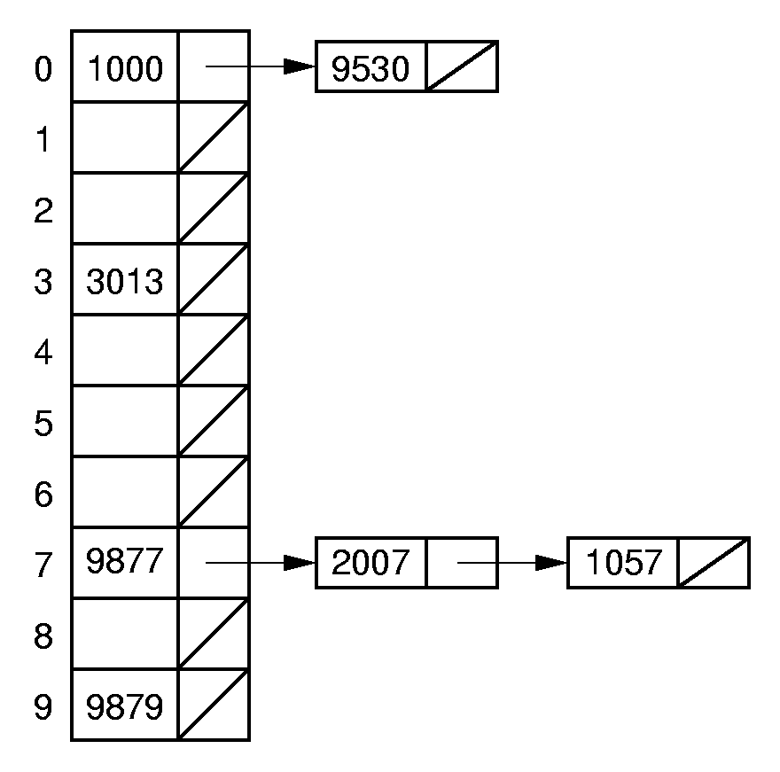
Chaining
What to do when collisions occur?
Chaining treats each hash table slot as a bin.
We hope to have n/N elements in each list.
Effective for a hash in memory, but difficult to implement efficiently on disk.

Slide 12
Bucket Hashing
Divide hash table slots into buckets
  Example, 8 slots per bucket
  Hash function maps to buckets
Global overflow bucket
Becomes inefficient when
overflow bucket is very full
Variation: map to home slot
as though no bucketing, then
check the rest of the bucket
Hash Table
Overflow
0
1000
1057
9530
1
2
9877
2007
3
3013
4
9879

Slide 13
Open Addressing
Open addressing stores all records directly in the hash table.
  Bucket hashing is a type of closed hasing
Each record i has a home position hash(key_{i}).
If another record occupies i’s home position, then another slot must be found to store i.
The new slot is found by a collision resolution policy.
Search must follow the same policy to find records not in their home slots.

Slide 14
Collision Resolution
During insertion, the goal of collision resolution is to find a free slot in the table.
Probe sequence: The series of slots visited during insert/search by following a collision resolution policy.
Let β₀ = hash(key). Let (β₀, β₁, …) be the series of slots making up the probe sequence.

Slide 15
Linear Probing: Insertion
HashInsert(hashTable, item) {
// Hash function determines initial bucket
bucket = Hash(item.key)
bucketsProbed = 0
N = hashTable's size
while (bucketsProbed < N) {
// Insert item in next empty bucket
if (hashTable[bucket] is Empty) {
hashTable[bucket] = item
return true }
// Increment bucket index
bucket = (bucket + 1) % N
// Increment number of buckets probed
++bucketsProbed
}
return false
}

Slide 16
Linear Probing Removal: Tombstones
HashRemove(hashTable, key) {
// Hash function determines initial bucket
bucket = Hash(key)
bucketsProbed = 0
while ((hashTable[bucket] is not EmptySinceStart) and
(bucketsProbed < N)) {
if ((hashTable[bucket] is not Empty) and
(hashTable[bucket]⇢key == key)) {
hashTable[bucket] = EmptyAfterRemoval // Tombstone!
return
}
// Increment bucket index
bucket = (bucket + 1) % N
// Increment number of buckets probed
++bucketsProbed
}
}

Slide 17
Linear Probing: Search
HashSearch(hashTable, key) {
// Hash function determines initial bucket
bucket = Hash(key)
bucketsProbed = 0
while ((hashTable[bucket] is not EmptySinceStart) and
(bucketsProbed < N)) {
if ((hashTable[bucket] is not Empty) and
(hashTable[bucket]⇢key == key)) {
return hashTable[bucket]
}
// Increment bucket index
bucket = (bucket + 1) % N
// Increment number of buckets probed
++bucketsProbed
}
return null // Item not found
}

Slide 18
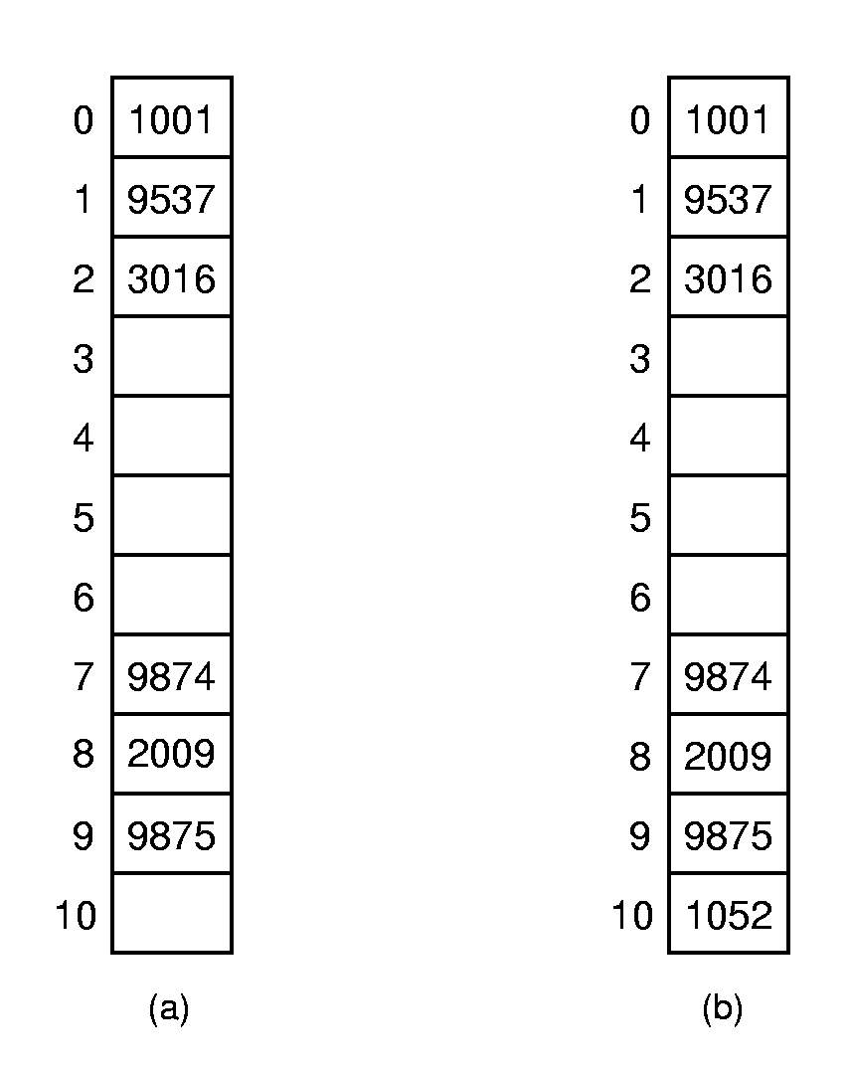
Linear Probing Example
Primary Clustering: Records tend to cluster in the table under linear probing since the probabilities for which slot to use next are not the same for all slots.
Ideally: equal probability for each slot at all times.
Notes:
For (a): prob(3) = 4/11, prob(4) = 1/11, prob(5) = 1/11, prob(6) = 1/11, prob(10) = 4/11.
For(b): prob(3) = 8/11, prob(4,5,6) = 1/11 each.

Slide 19
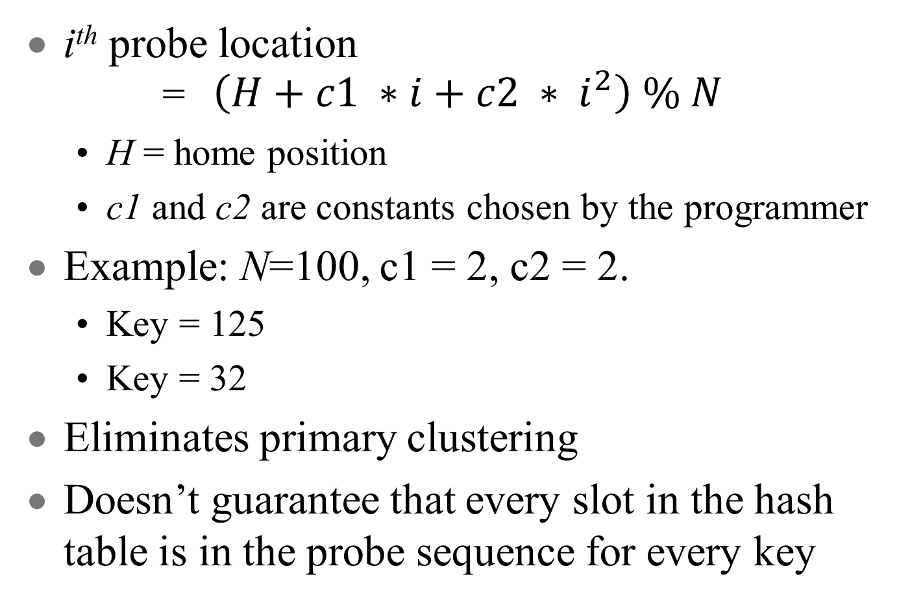
Quadratic probing

Slide 20
Pseudo-random Probing
Ideally, for any two keys, k₁ and k₂, the probe sequences should diverge.
An ideal probe function would select the next value in the probe sequence at random.
  Why can’t we do this?
Select a random permutation of the numbers from 1 to N−1:
    Perm = [r₁, r₂, r₃, …, r_{M-1}]
p(K, i) = Perm[i-1];

Slide 21
Pseudo-random probe example
Example: Hash table size of N = 101
  Perm = [2, 5, 32, …]
  h(k₁)=30, h(k₂)=28.
  Probe sequence for k₁: 30, 32, 35, 62
  Probe sequence for k₂: 28, 30, 33, 60
  Although they temporarily converge, they quickly diverge again afterwards

Slide 22
Secondary Clustering
Pseudo-random probing eliminates primary clustering.
If two keys hash to the same slot, they follow the same probe sequence. This is called secondary clustering.
To avoid secondary clustering, need probe sequence to be a function of the original key value, not just the home position.
  None of the probe functions we have looked at use K in any way!

Slide 23
Double hashing
One way to get a probe sequence that depends on K is to use linear probing, but to have the constant be different for each K
  We can use a second hash function to get the constant: p(K, i) = h₁(K)+ i × h₂(K)
  where h₂ is another hash function
Example: Hash table of size N=101
  h(k₁)=30, h(k₂)=28, h(k₃)=30.
  h₂(k₁)=2, h₂(k₂)=5, h₂(k₃)=5.
  Probe sequence for k₁ is: 30, 32, 34, 36
  Probe sequence for k₂ is: 28, 33, 38, 43
  Probe sequence for k₃ is: 30, 35, 40, 45

Slide 24
How do we pick the two hash functions
A good implementation of double hashing should ensure that all values of the second hash function are relatively prime to N.
If N is prime, than h₂() can return any number from 1 to N−1
If N is 2^{m} than any odd number between 1 and m will do

Slide 25
How fast is hashing?
When a record is found in its home position, search takes O(1) time.
As the table fills, the probability of collision increases
Define the load factor for a table as α = n/N, where n is the number of records currently in the table

Slide 26
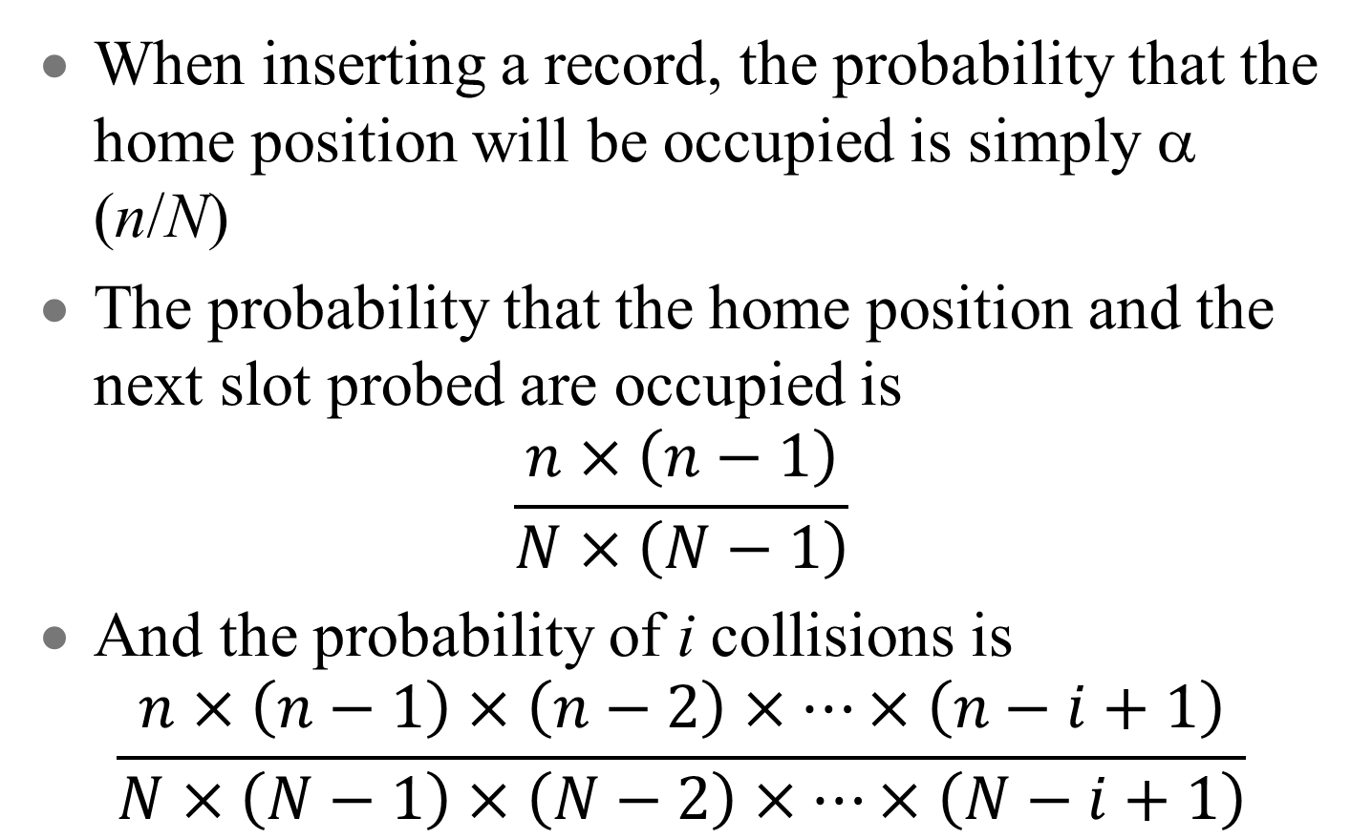
Analysis of hashing

Slide 27
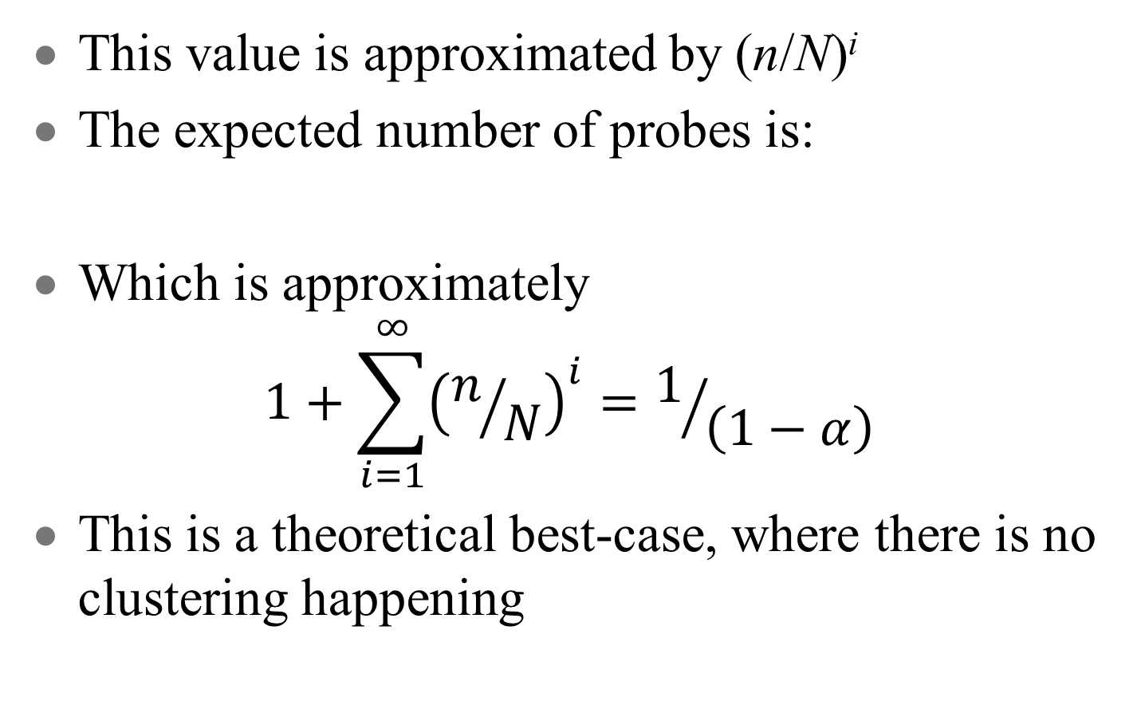
Analysis of hashing (2)
This value is approximated by (n/N)^{i}
The expected number of probes is:
Which is approximately
$$1+\sum_{i=1}^{∞}{{\left(n/N\right)}^{i}=1/{\left(1−α\right)}}$$
This is a theoretical best-case, where there is no clustering happening

Slide 28
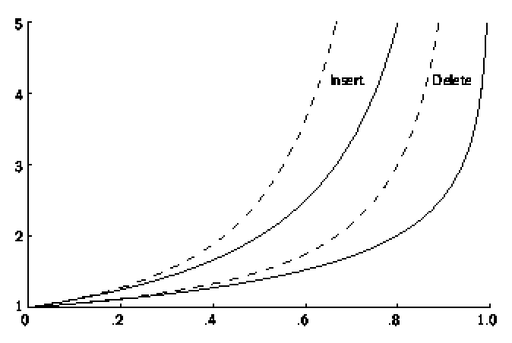
Hashing Performance
= no clustering (theoretical bound)
= linear probing (lots of clustering)
Expected number of accesses
α

Slide 29
Deletion
Deleting a record must not hinder later searches.
Remember, we stop the search through the probe sequence when we find an empty slot.
We do not want to make positions in the hash table unusable because of deletion.

Slide 30
Tombstones (1)
Both of these problems can be resolved by placing a special mark in place of the deleted record, called a tombstone.
A tombstone will not stop a search, but that slot can be used for future insertions.

Slide 31
Tombstones (2)
Unfortunately, tombstones add to the average path length.
Solutions:
Local reorganizations to try to shorten the average path length.
Periodically rehash the table (by order of most frequently accessed record).

